Slide 1
Sarvajanik College Of Engineering & Technology, Surat “Moonlight”
Submitted By Guided By
Hemant Patil [205310694018]
Harshal Randhire [205310694020] Prof. Kaushika Pal
Ramdhan Vanjara [205310694024] ]

Slide 2
Content
Objective of the New System
Problem Solving
Core Components
Module
Use-Case Diagram
Database
Screen Shot

Slide 3
Objective of the New System
The main objective of the project on online cloth selling is it manage the details of products, Order, User, Payments.
It manage all the information about products.
It allow to user select the category of product as per their need..
Site have a login facility to user log in their account for products order.

Slide 4
Problem Solving
Our mission is to provide a platform for buy online products.
The user can save the products in the cart.
The user select the multiple products at one time.
Customer can order products online easily.

Slide 5
Core Components
Authenticate User
User can sing in using Email address.
User fill up the Register From and redirect to the log in page
User also selecting category for buy products
Products
Admin add the products and products category on site
User browse the products on as per category
user add the products on cart to click add to cart and buy the products

Slide 6
Core Components
Order
Admin view the all orders by user
Admin manage the all orders
User buy the products for selected category
User remove item in the order

Slide 7
Module
Moonlight
Admin
User

Slide 8
Admin
Log In / Log out
Manage Products
Manage Category
Manage Page
Manage Orders

Slide 9
User
Log in / log out
Registration
Add To Cart
Manage Orders
Order Details
Payment

Slide 10
Use-Case Diagram
Moonlight
Admin
User

Slide 11
Admin
Admin Login
Admin
Log In

Slide 12
Admin
Log Out
Manage Products
Manage Category
Log In
Manage Page
Manage Orders

Slide 13
Admin
Manage Product
Delete
Update
Manage
Products
Admin
Log In
Add
Search
Status

Slide 14
Admin
Manage Category
Update
Manage
Category
Admin
Log In
Add
Delete

Slide 15
Admin
Manage Orders
Update
Manage
Orders
Admin
Log In
Add
Delete

Slide 16
User
User Login
Log In
User

Slide 17
User
LogOut
Manage Order
Add To Cart
Log In
Payment
Manage Address

Slide 18
User
Add To Cart
Update
Add to
Cart
User
Log In
Add
Remove

Slide 19
User
Manage Profile
Update
Manage
Order
User
Log In
View

Slide 20
Activity Diagram
Activity Diagram of Overall Admin site :

Slide 21
Admin Site Activity Diagram

Slide 22
Admin Site Activity Diagram

Slide 23
User Site Activity Diagram
Activity Diagram of Overall User site :

Slide 24
User Site Activity Diagram
Activity Diagram of Manage Order

Slide 25
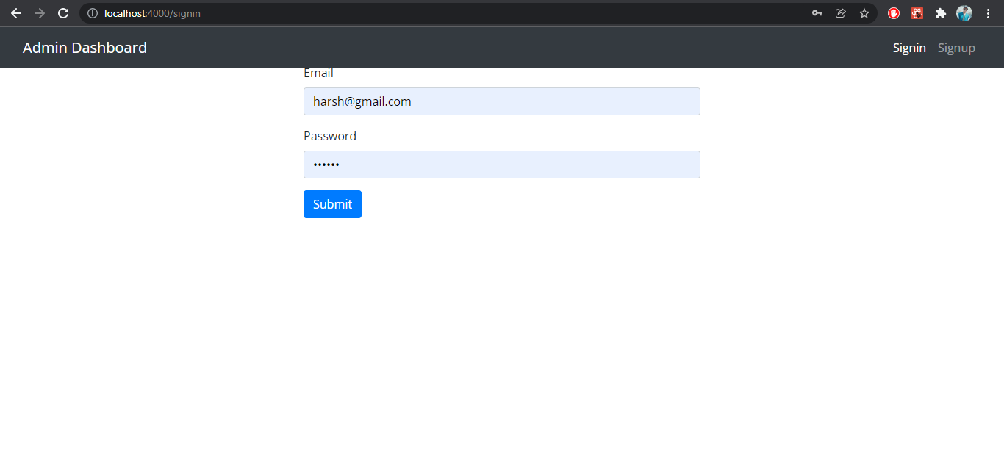
Screen Shots
Admin Site:
Log In page:
Description : This page use for admin login

Slide 26
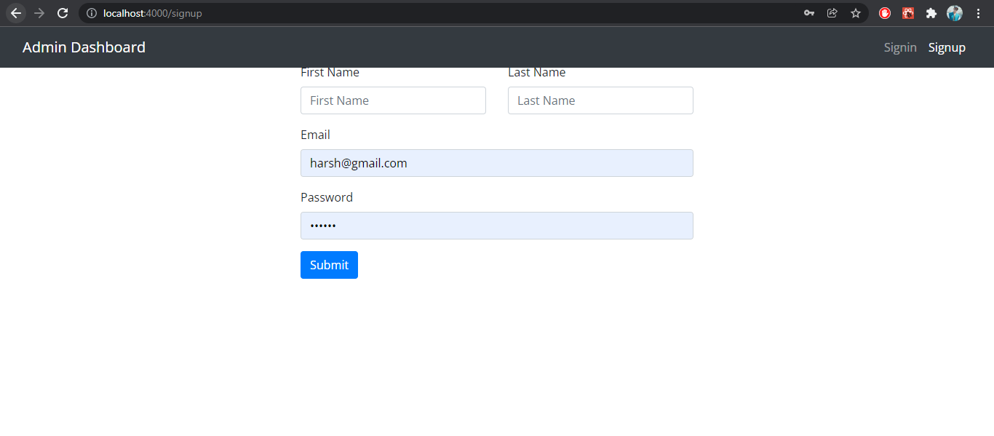
Admin Sing Up Page:
Description : This page is Admin Site Sing Up Page

Slide 27
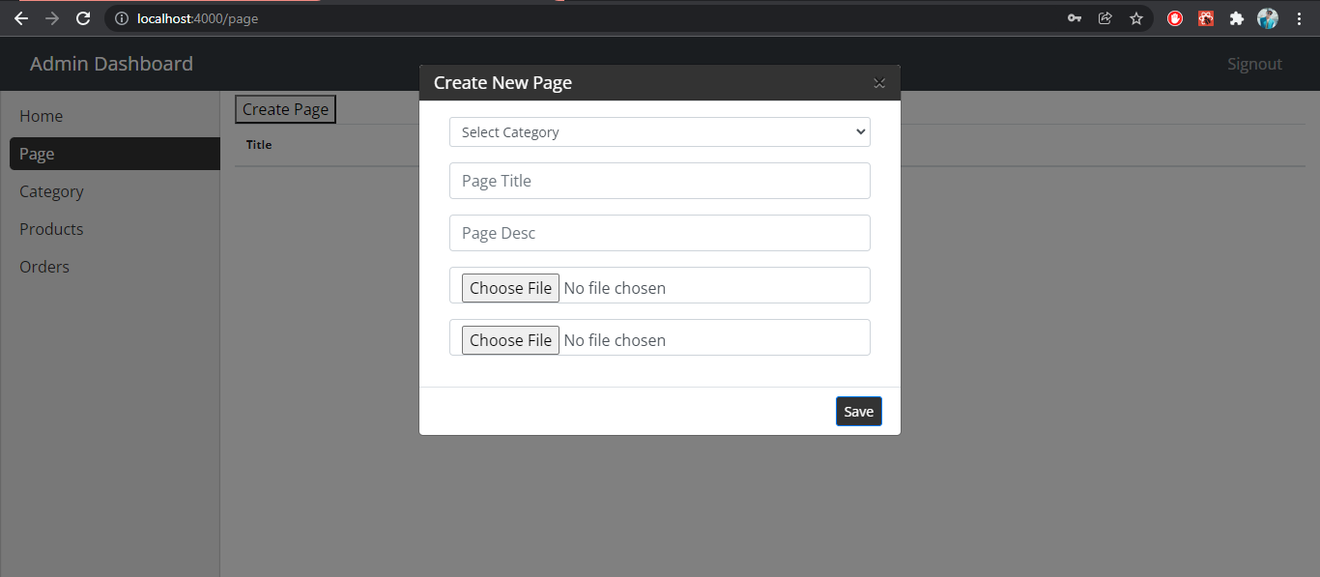
Create Page:
Description : This page use for Create Page.

Slide 28
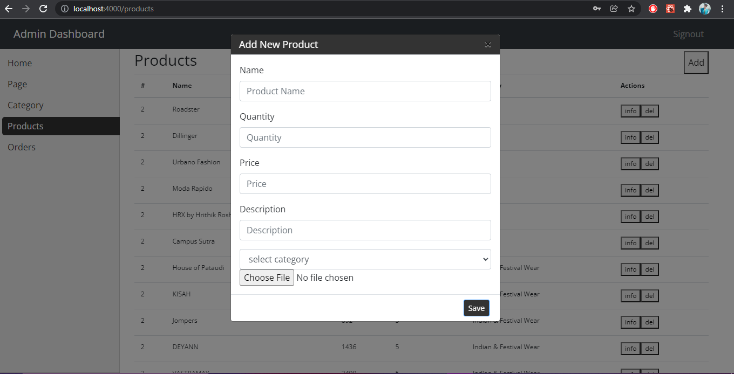
Add Product
Description : This page use for Add Product

Slide 29
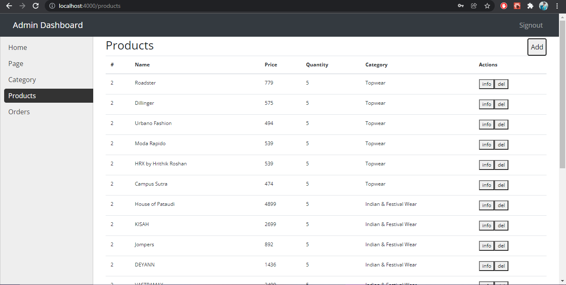
View Product
Description : This page use for View Product

Slide 30
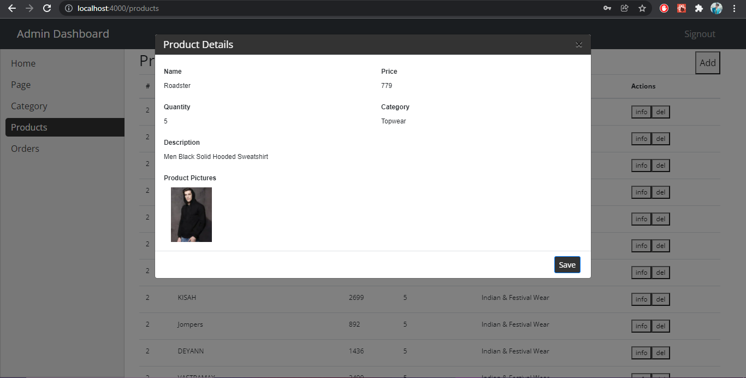
View Product Details
Description : This page use for View Product

Slide 31
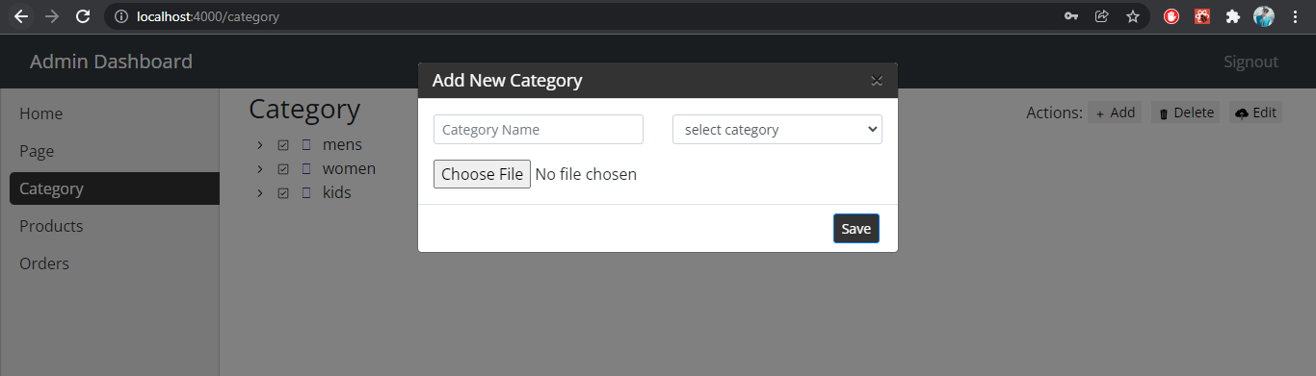
Add Category
Description : This page use for Add Category

Slide 32
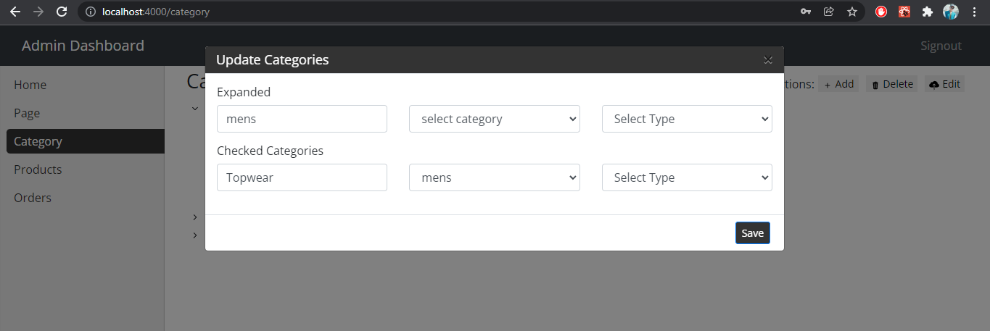
Edit Category
Description : This page use for Edit Category

Slide 33
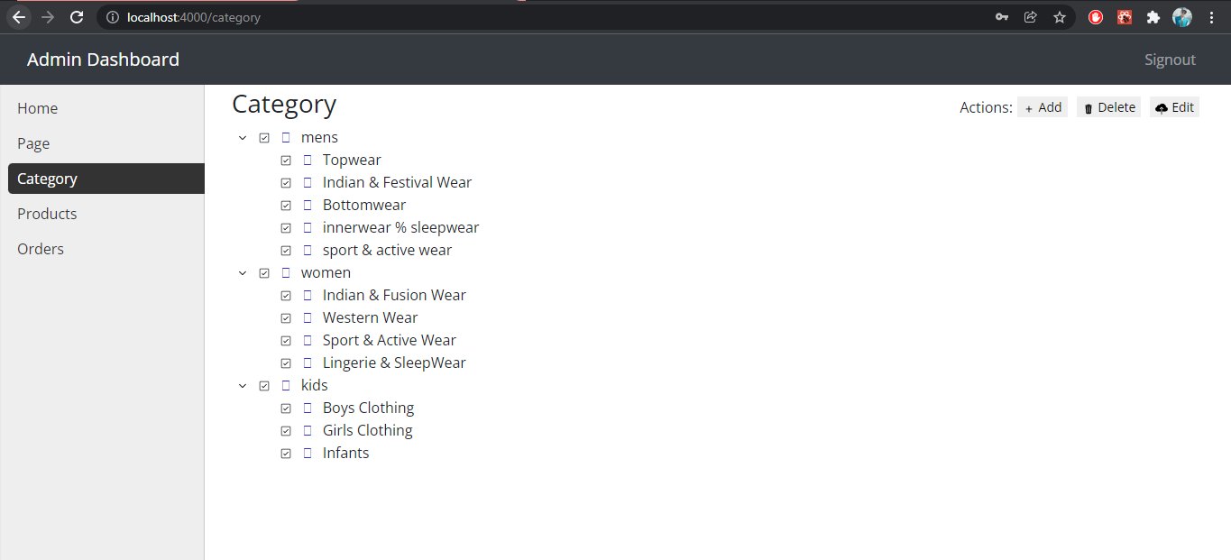
Display Category
Description : This page use for Display Category

Slide 34
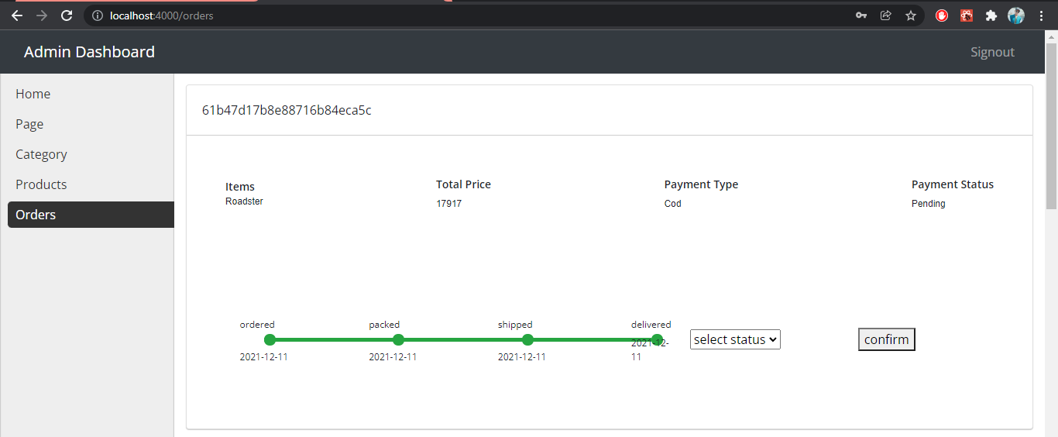
View Orders
Description : This page use for View orders and Status

Slide 35
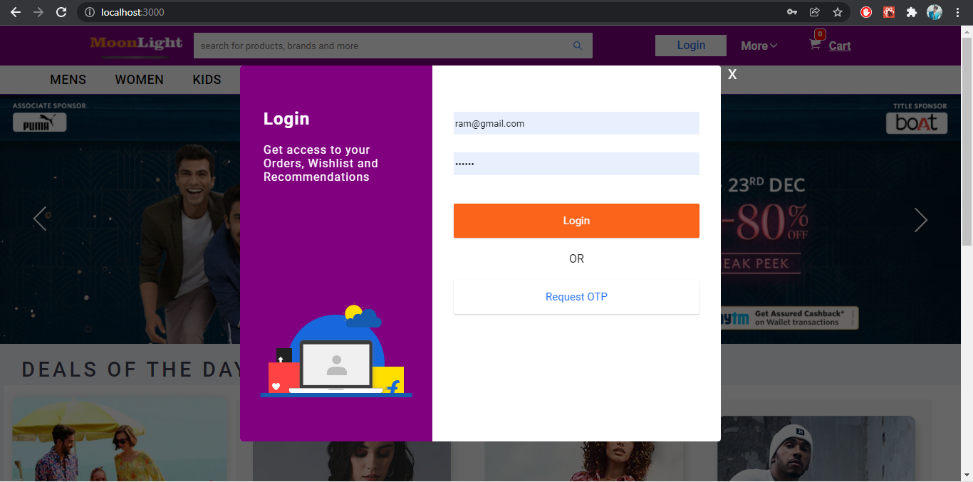
User Site: Log In:
Description : This page use for User Login

Slide 36
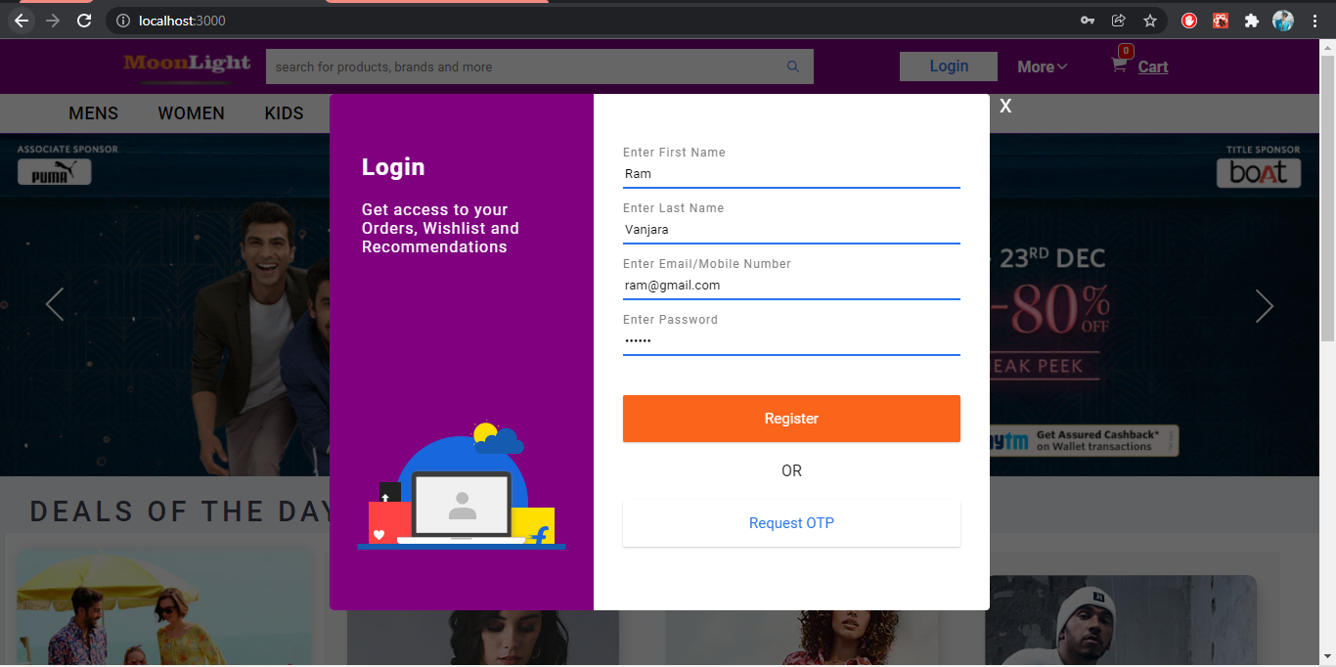
Register Page
Description : This page use for User Registretion

Slide 37
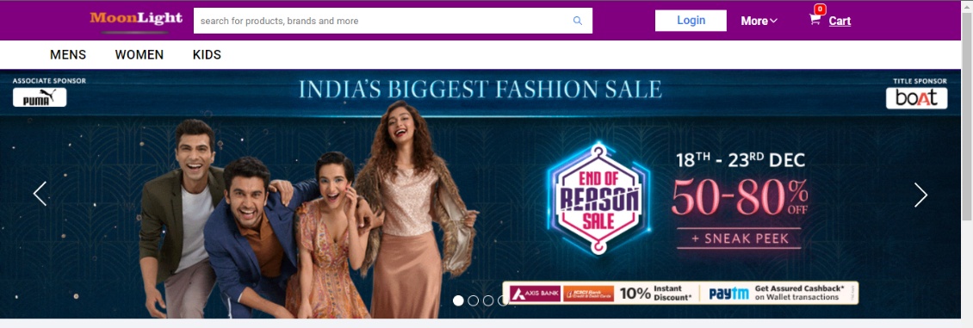
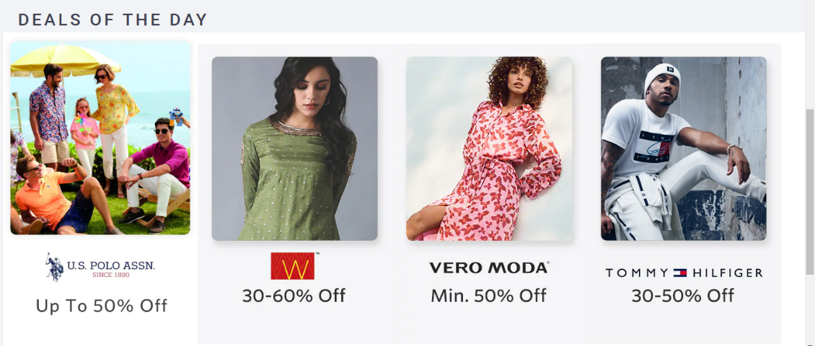
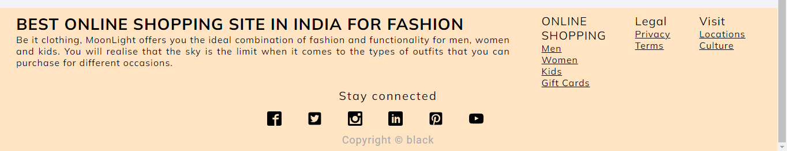
User Dashboard
Description : This is a home page.

Slide 38
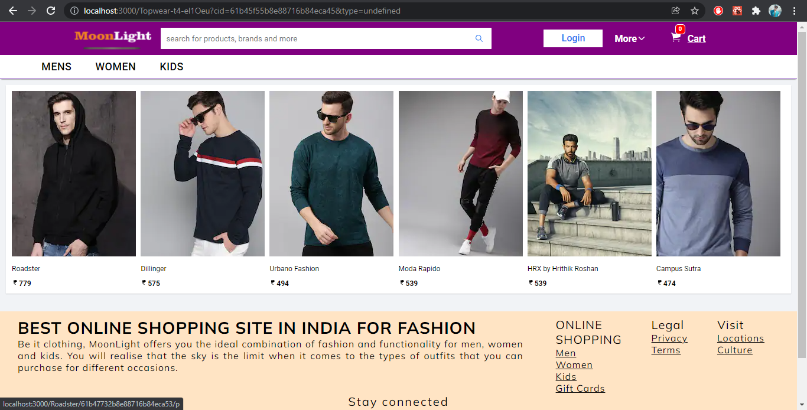
Products
Description : This is a Product page.

Slide 39
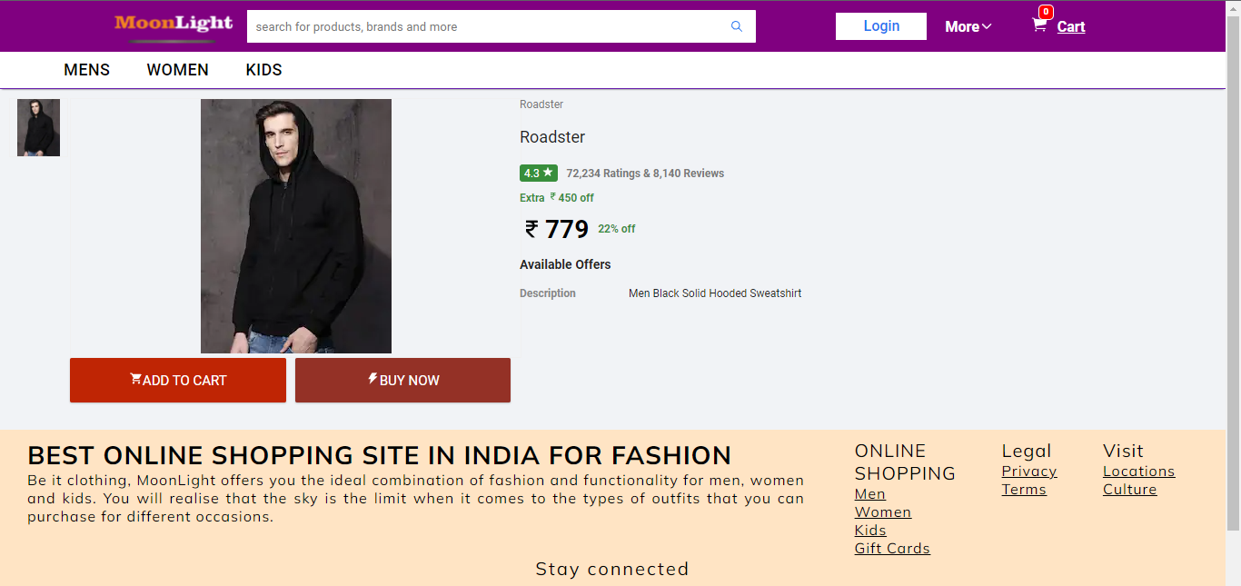
Product Details
Description : This is a product details page.

Slide 40
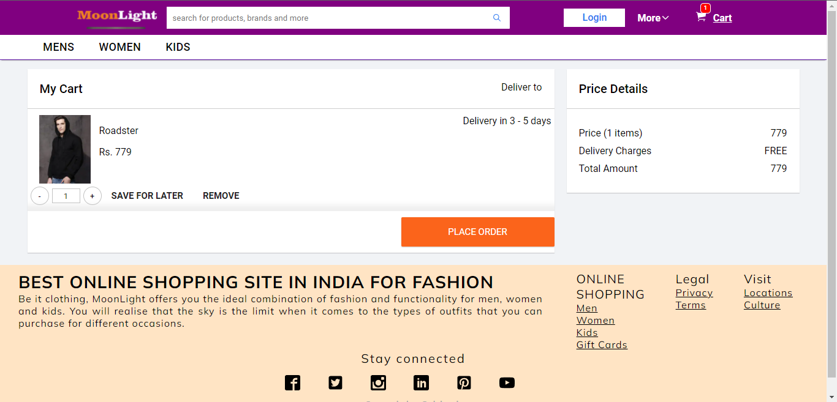
Add to Cart
Description : This is a Add to Cart page.

Slide 41
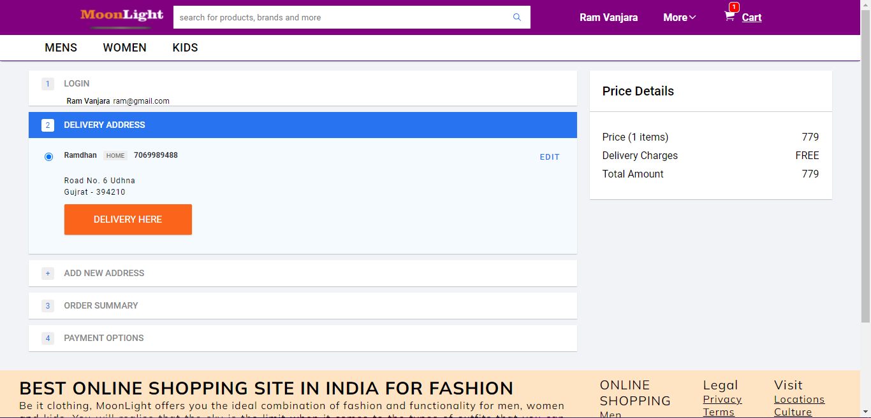
Delivery address
Description : This page is use for delivery the product on users address

Slide 42
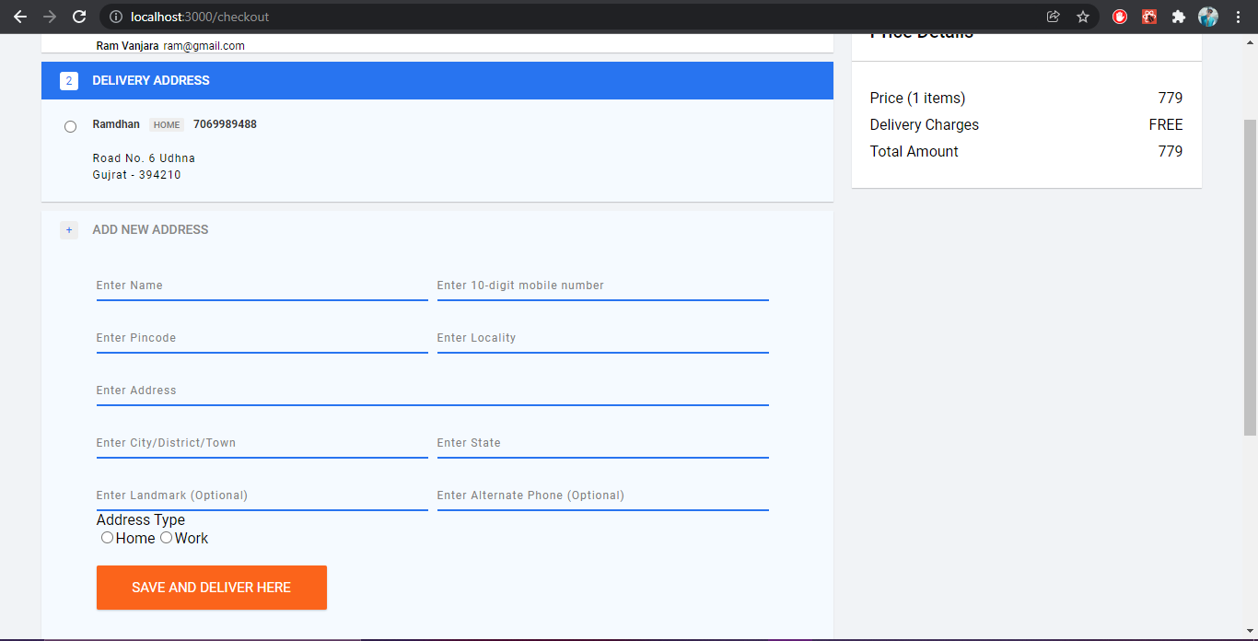
New Delivery address
Description : This page is use for add new address for product delivery

Slide 43
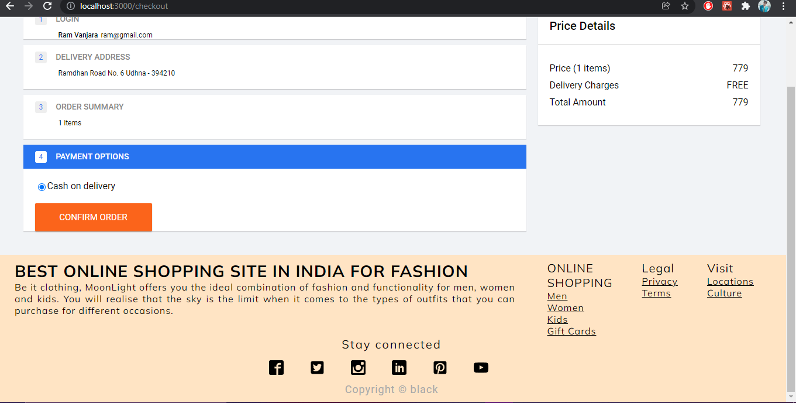
Confirm Order
Description : This page is use for confirm order

Slide 44
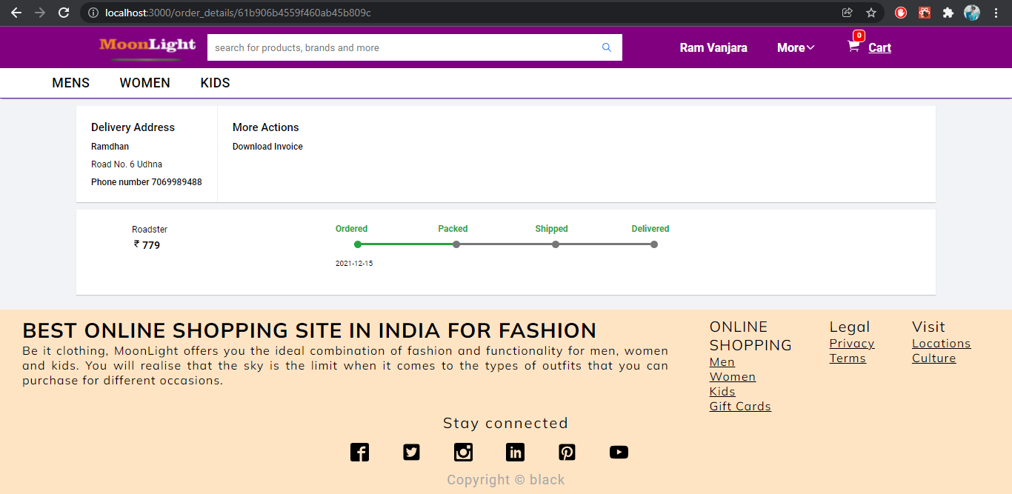
Orders Details
Description : This page is use for display orders details of users

